Slide 1

PROJECT CARD
EASY
ADVANCED

Slide 2

PROJECT CARD
GOAL:
Build, train, test and deploy a machine learning model to predict chances of university admission into a particular university given student’s profile.
TOOL:
AWS SageMaker – Launching a Training job from the Management Console
PRACTICAL REAL-WORLD APPLICATION:
This project can be effectively used by university admission departments to determine top qualifying students.
DATA:
INPUTS (FEATURES):
GRE Scores (out of 340)
TOEFL Scores (out of 120)
University Rating (out of 5)
Statement of Purpose (SOP)
Letter of Recommendation (LOR) Strength (out of 5)
Undergraduate GPA (out of 10)
Research Experience (either 0 or 1)
OUTPUTS:
Chance of admission (ranging from 0 to 1)
Image Source: https://www.flickr.com/photos/pasa/6757993805
Dataset Source: https://www.kaggle.com/ljanjughazyan/cars1
Data Source: https://www.kaggle.com/mohansacharya/graduate-admissions
Photo Credit: https://www.pexels.com/photo/accomplishment-ceremony-education-graduation-267885/

Slide 3
PROJECT OVERVIEW
INPUTS
GRE Score
TOEFL Score
University Rating
Statement of Purpose (SOP)
Letter of Recommendation (LOR)
CGPA
Research
MACHINE LEARNING MODEL
OUTPUT
Chance of Admission

Slide 4
THE RISE OF MACHINE LEARNING IN HIGHER EDUCATION
EASY
ADVANCED

Slide 5
THE RISE OF MACHINE LEARNING IN HIGHER EDUCATION
Machine Learning and Artificial Intelligence have been transforming higher education in many areas such as:
Marketing and Recruiting
Students Admission and Enrollment
Curriculum and Resources Planning and Forecasting
Pedagogy and Personalized Students Learning Experience
Students Support (AI-Powered Counseling)
Reference: https://er.educause.edu/articles/2019/8/artificial-intelligence-in-higher-education-applications-promise-and-perils-and-ethical-questions

Slide 6


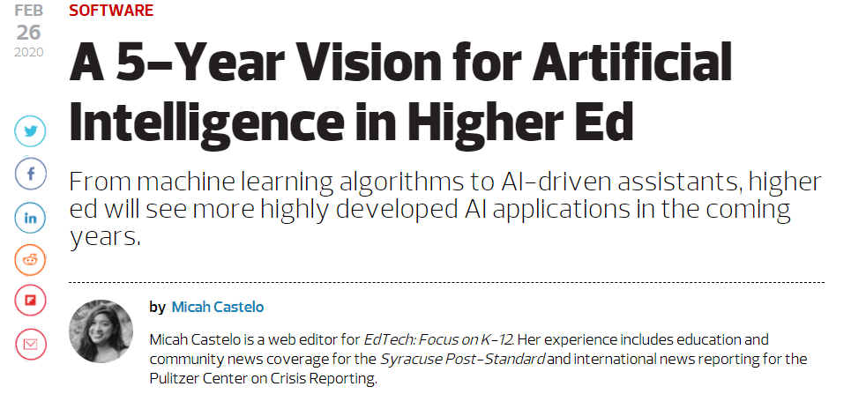
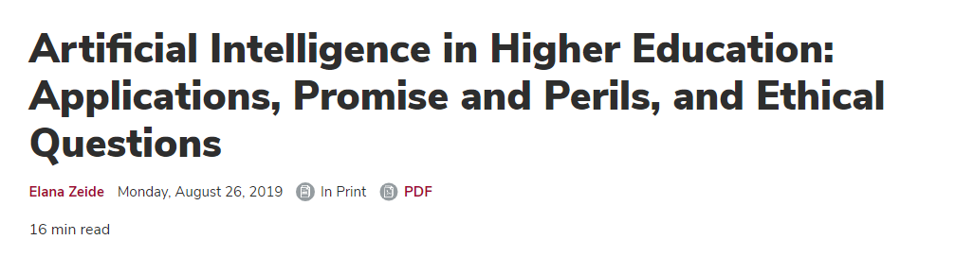
READING TIME & QUIZ: THE RISE OF AI IN HIGHER EDUCATION
Please read the 2 articles below and answer the following quiz.
https://edtechmagazine.com/higher/article/2020/02/5-year-vision-artificial-intelligence-higher-ed
https://er.educause.edu/articles/2019/8/artificial-intelligence-in-higher-education-applications-promise-and-perils-and-ethical-questions
15 MINS
10 MINS

Slide 7
MACHINE LEARNING REGRESSION RECAP
EASY
ADVANCED

Slide 8

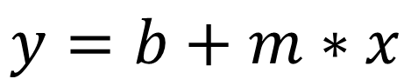
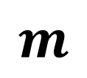
SIMPLE LINEAR REGRESSION
Regression works by predicting value of one variable Y based on another variable X.
X is called the independent variable and Y is called the dependant variable.
Goal is to obtain a relationship (model) between two variables only such as age and insurance cost for example.
MODEL! (GOAL)
$$y=b+m∗x$$
$$m$$
CHANCES OF ADMISSION
$$b$$
DEPENDANT VARIABLE
CHANCE OF ADMISSION
INDEPENDENT VARIABLE
GRE SCORE
GRE SCORE

Slide 9
MULTIPLE LINEAR REGRESSION
Multiple Linear Regression: examines relationship between more than two variables.
Recall that Simple Linear regression is a statistical model that examines linear relationship between two variables only.
Each independent variable has its own corresponding coefficient.
$$y=b_{0}+b_{1}∗x_{1}+b_{2}∗x_{2}+..+b_{n}x_{n}$$
CHANCE OF ADMISSION
(RANGE 0-1)
INDEPENDENT VARIABLES
(GRE SCORE, GPA, TOEFL SCORES..ETC)

Slide 10
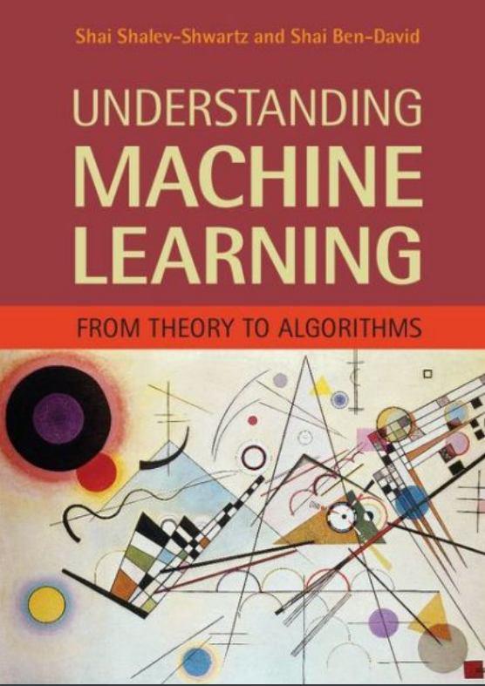
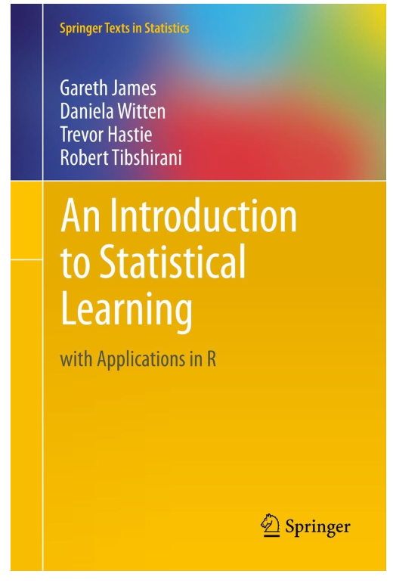
ADDITIONAL READING MATERIAL
Additional Resources, Page #123: http://www.cs.huji.ac.il/~shais/UnderstandingMachineLearning/understanding-machine-learning-theory-algorithms.pdf
Additional Resources, Page #61:
http://www-bcf.usc.edu/~gareth/ISL/ISLR%20Seventh%20Printing.pdf

Slide 11
PRACTICE OPPORTUNITY
EASY
ADVANCED

Slide 12
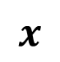
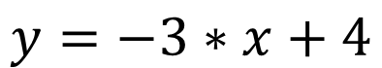

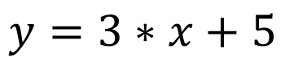

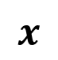


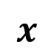
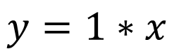
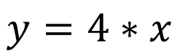

$$y=3∗x+5$$
PRACTICE OPPORTUNITY:
$$y=1∗x$$
Match the equations to the figures below and explain why:
$$y=−3∗x+4$$
$$y=4∗x$$
$$y$$
$$y$$
$$y$$
$$x$$
$$x$$
$$x$$
$$y$$
$$x$$

Slide 13
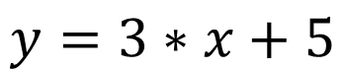



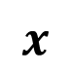

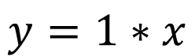
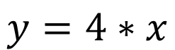



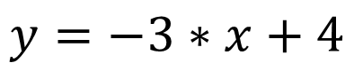
PRACTICE OPPORTUNITY SOLUTION:
Match the equations to the figures below and explain why:
$$y$$
$$y$$
$$y$$
$$x$$
$$x$$
$$x$$
$$y=4∗x$$
$$y=3∗x+5$$
$$y=1∗x$$
$$y$$
$$x$$
$$y=−3∗x+4$$

Slide 14
LAUNCH A TRAINING JOB FROM AWS CONSOLE DEMO PART #1
EASY
ADVANCED

Slide 15
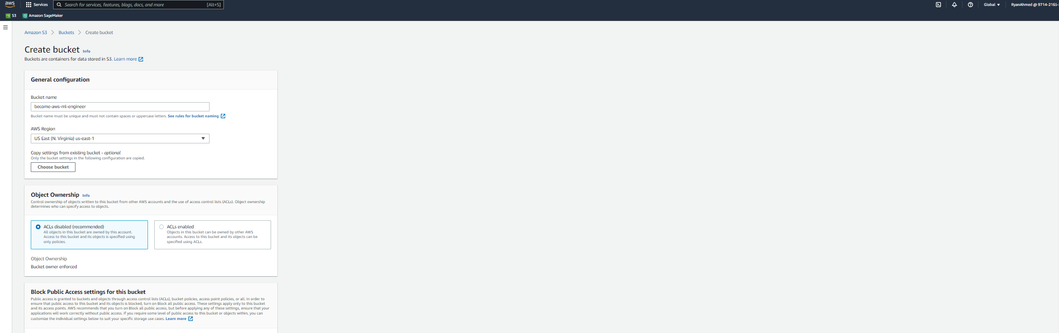
DEMO: LAUNCH TRAINING JOB FROM AWS CONSOLE
CREATE AN S3 BUCKET AND UPLOAD THE TRAINING DATASETS

Slide 16
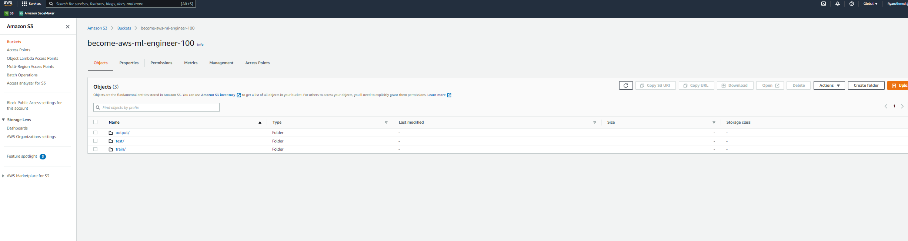
DEMO: LAUNCH TRAINING JOB FROM AWS CONSOLE
CREATE THREE FOLDERS FOR TRAIN, TEST AND OUTPUT. NOTE THAT THE OUTPUT IS THE LOCATION TO STORE THE MODEL ARTIFACTS

Slide 17
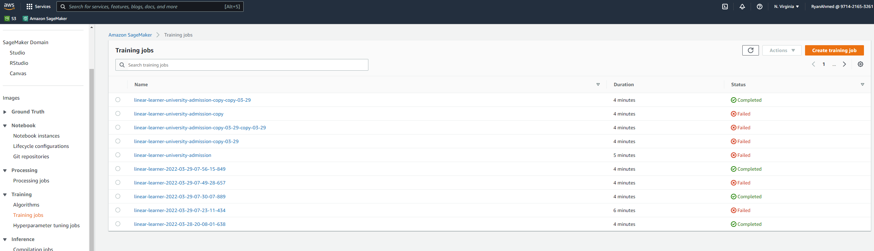
DEMO: LAUNCH TRAINING JOB FROM AWS CONSOLE
NAVIGATE TO SAGEMAKER AND CLICK ON TRAINING JOBS AND THEN CREATE TRAINING JOB

Slide 18
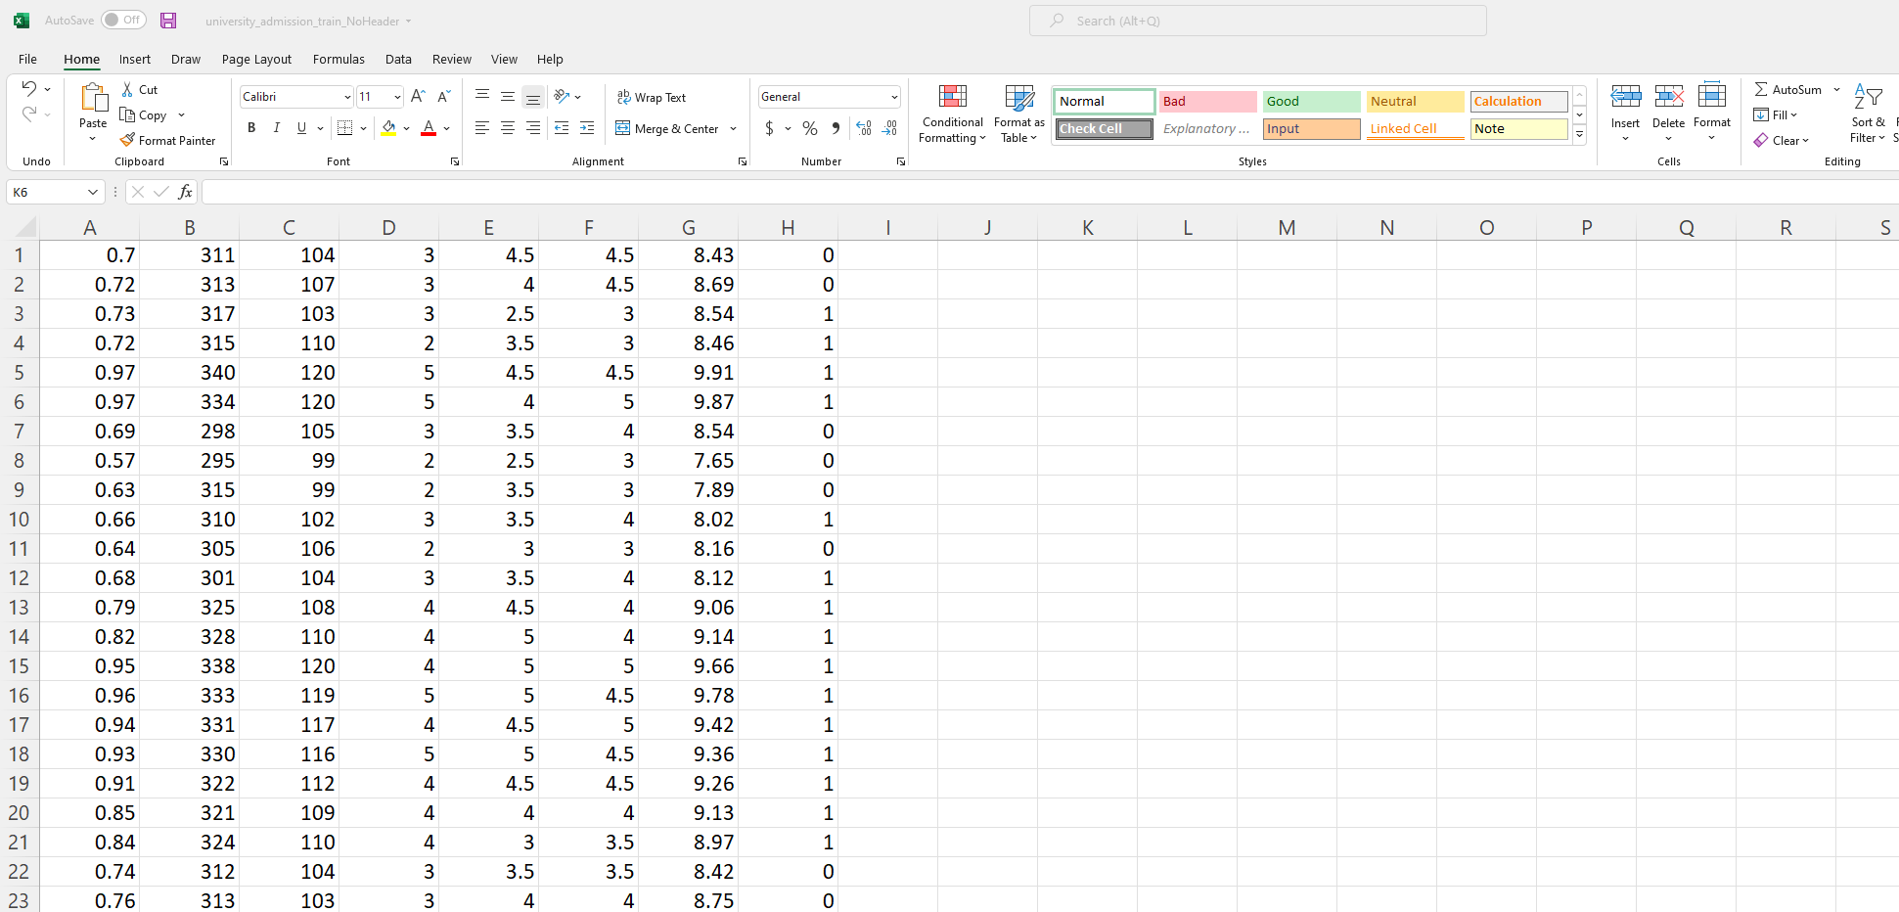
DEMO: LAUNCH TRAINING JOB FROM AWS CONSOLE
NOTE THAT THE TARGET OUTPUT IS IN THE FIRST COLUMN. MAKE SURE THAT NO HEADERS ARE PRESENT.

Slide 19
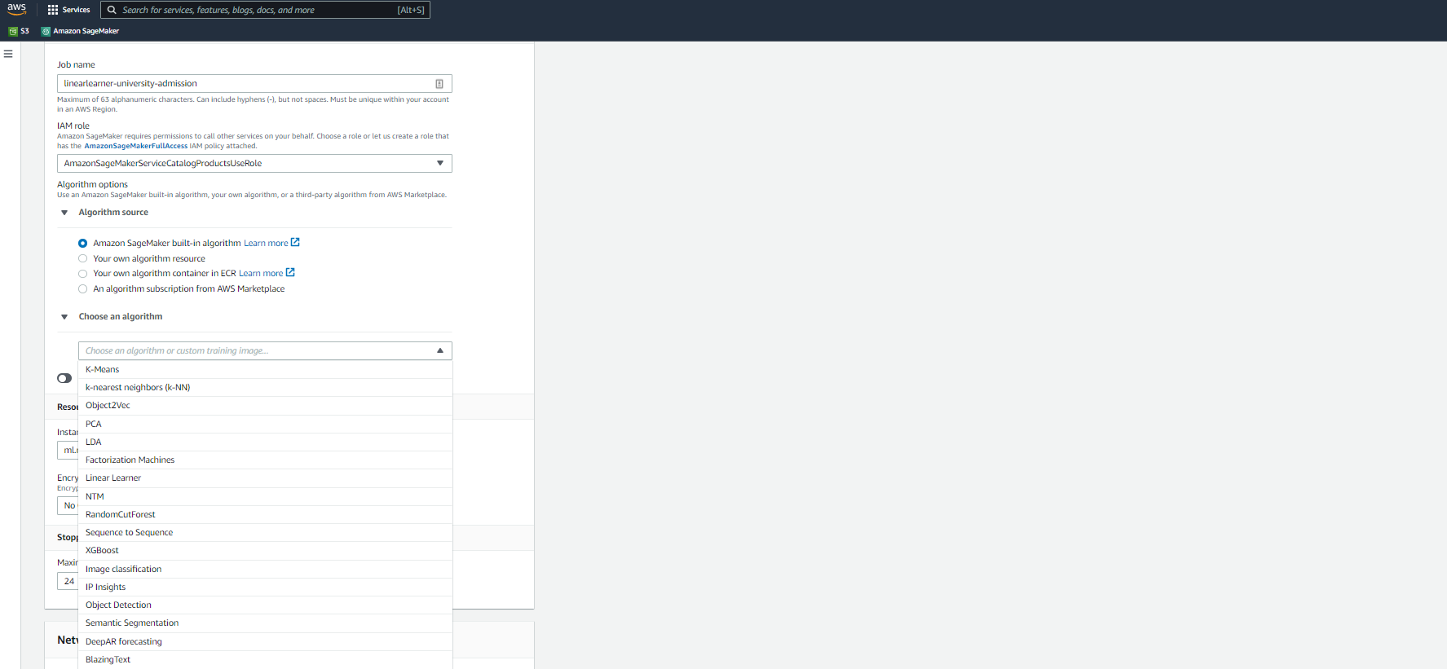
DEMO: LAUNCH TRAINING JOB FROM AWS CONSOLE
PROVIDE A NAME AND CHOOSE A LINEAR LEARNER ALGORITHM

Slide 20
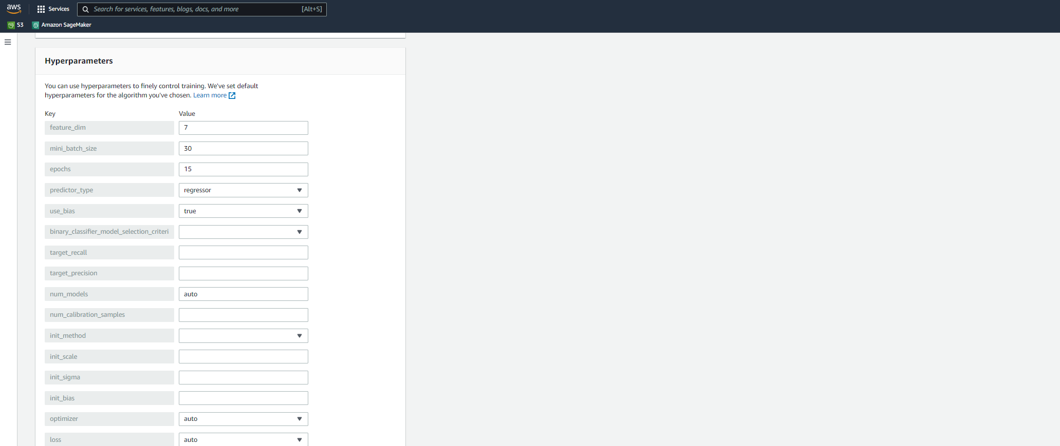
DEMO: LAUNCH TRAINING JOB FROM AWS CONSOLE
PROVIDE FEATURE DIMENSION, MINI_BATCH_SIZE AND PREDICTOR TYPE (YOU WILL GET AN ERROR IF YOU DON’T PROVIDE THEM.

Slide 21
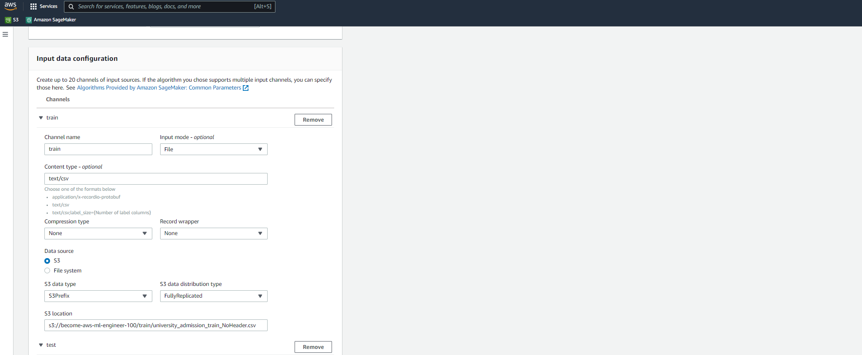
DEMO: LAUNCH TRAINING JOB FROM AWS CONSOLE
PROVIDE THE PATH TO THE TRAINING DATASET IN S3

Slide 22
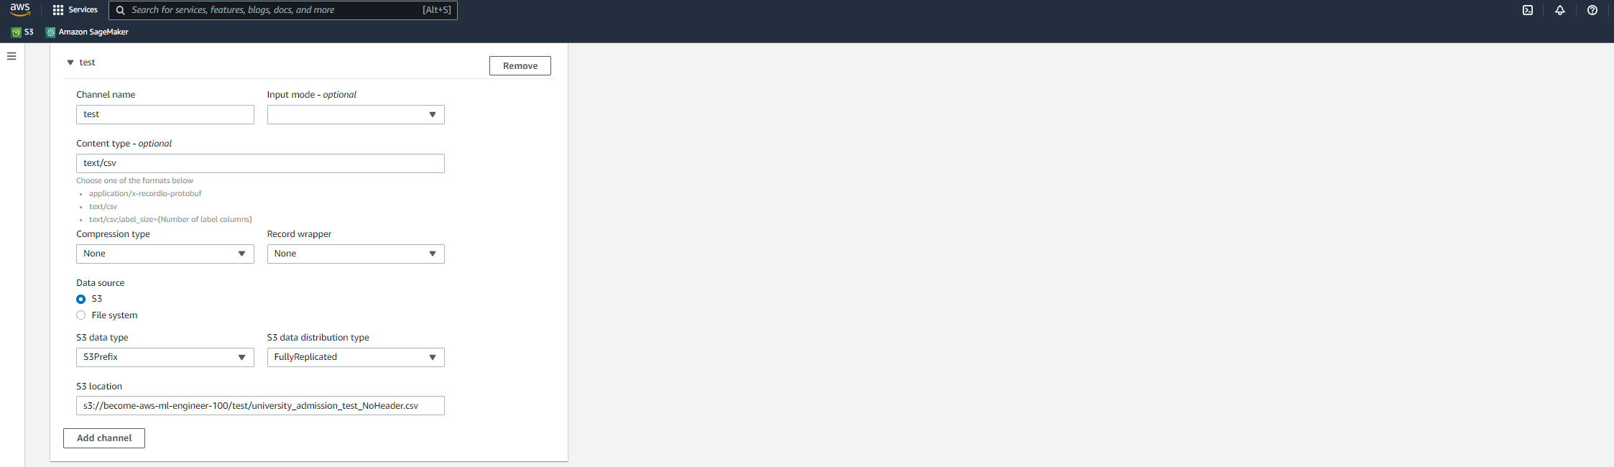
DEMO: LAUNCH TRAINING JOB FROM AWS CONSOLE
PROVIDE THE PATH TO THE TESTING DATASET IN S3

Slide 23
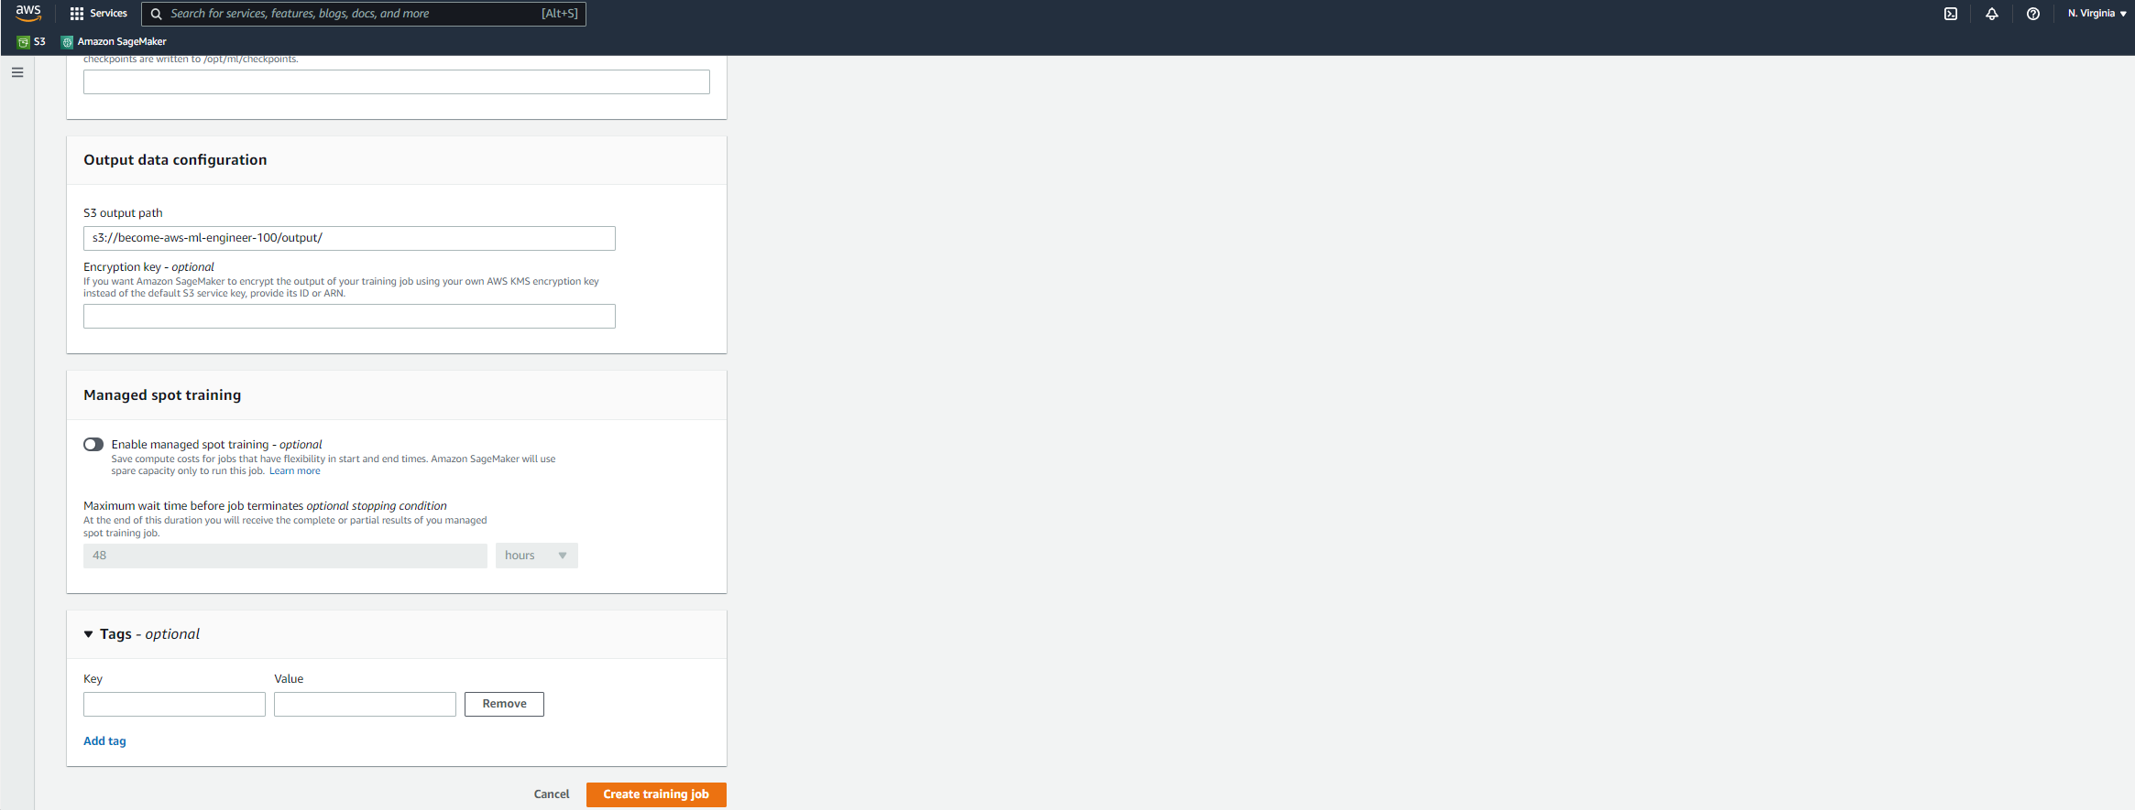
DEMO: LAUNCH TRAINING JOB FROM AWS CONSOLE
SET THE OUTPUT LOCATION AND YOU CAN ENABLE SPOT INSTANCE AS WELL TO SAVE COSTS. CREATE TRAINING JOB.

Slide 24
LAUNCH A TRAINING JOB FROM AWS CONSOLE DEMO PART #2
EASY
ADVANCED

Slide 25
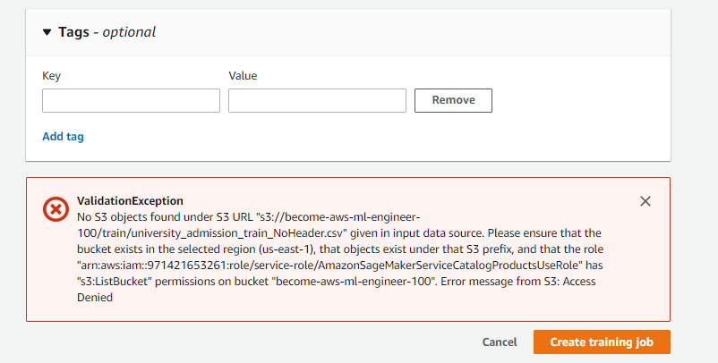
DEMO: LAUNCH TRAINING JOB FROM AWS CONSOLE
NOTE THAT YOU MIGHT GET THIS ERROR MESSAGE. THIS IS BECAUSE SAGEMAKER DOES NOT HAVE ACCESS TO THE S3 BUCKET. LET’S CHANGE THAT!

Slide 26
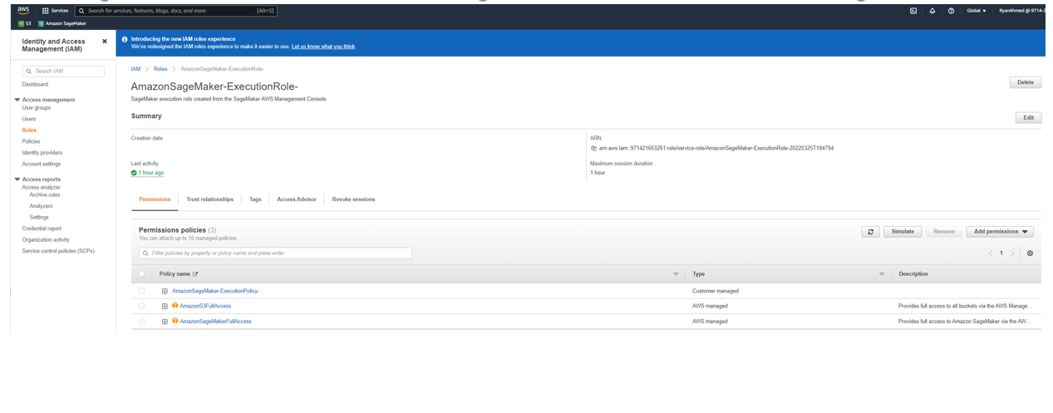
DEMO: LAUNCH TRAINING JOB FROM AWS CONSOLE
NAVIGATE TO IAM AND ATTACH AMAZONS3FULLACCESS TO THE SAGEMAKER EXECUTION ROLE

Slide 27
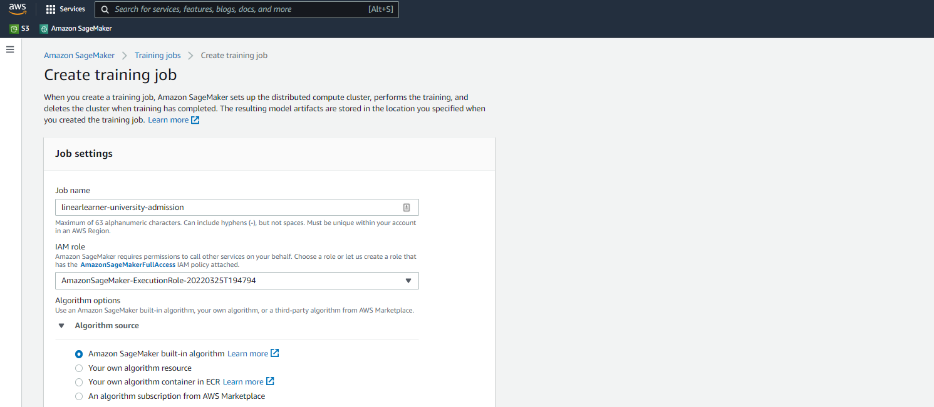
DEMO: LAUNCH TRAINING JOB FROM AWS CONSOLE
SELECT THE SAGEMAKER EXECUTION ROLE THAT HAS FULL S3 ACCESS. IT SHOULD WORK NOW!

Slide 28
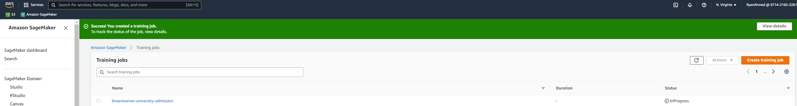
DEMO: LAUNCH TRAINING JOB FROM AWS CONSOLE
TRAINING JOB HAS STARTED!

Slide 29
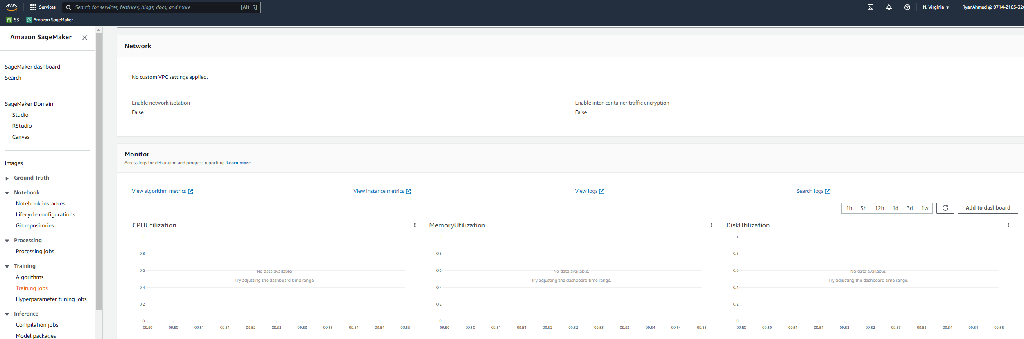
DEMO: LAUNCH TRAINING JOB FROM AWS CONSOLE
ONCE THE TRAINING JOB IS COMPLETE. NAVIGATE TO VIEW ALGORITHM METRICS TO ASSESS TRAINED MODEL PERFORMANCE.

Slide 30
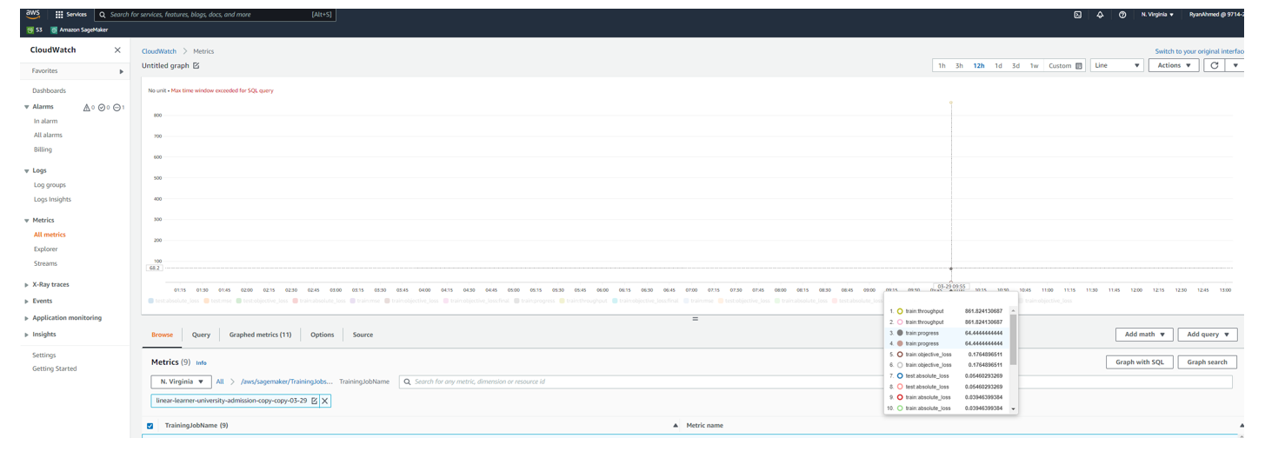
DEMO: LAUNCH TRAINING JOB FROM AWS CONSOLE
ONCE THE TRAINING JOB IS COMPLETE. NAVIGATE TO VIEW ALGORITHM METRICS TO ASSESS TRAINED MODEL PERFORMANCE. NOTE THAT YOU ARE WATCHING ALL THESE METRICS IN CLOUDWATCH.

Slide 31
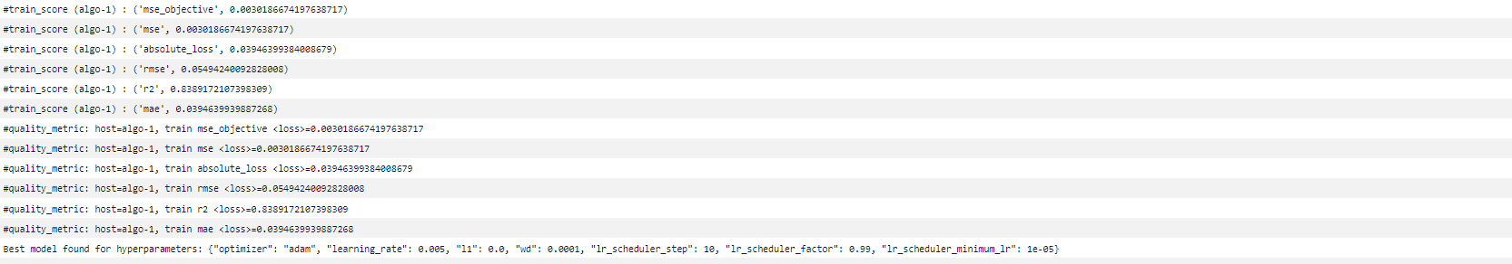
DEMO: LAUNCH TRAINING JOB FROM AWS CONSOLE
CLICK ON VIEW LOGS AND VIEW THE TRAINING JOB METRICS

Slide 32
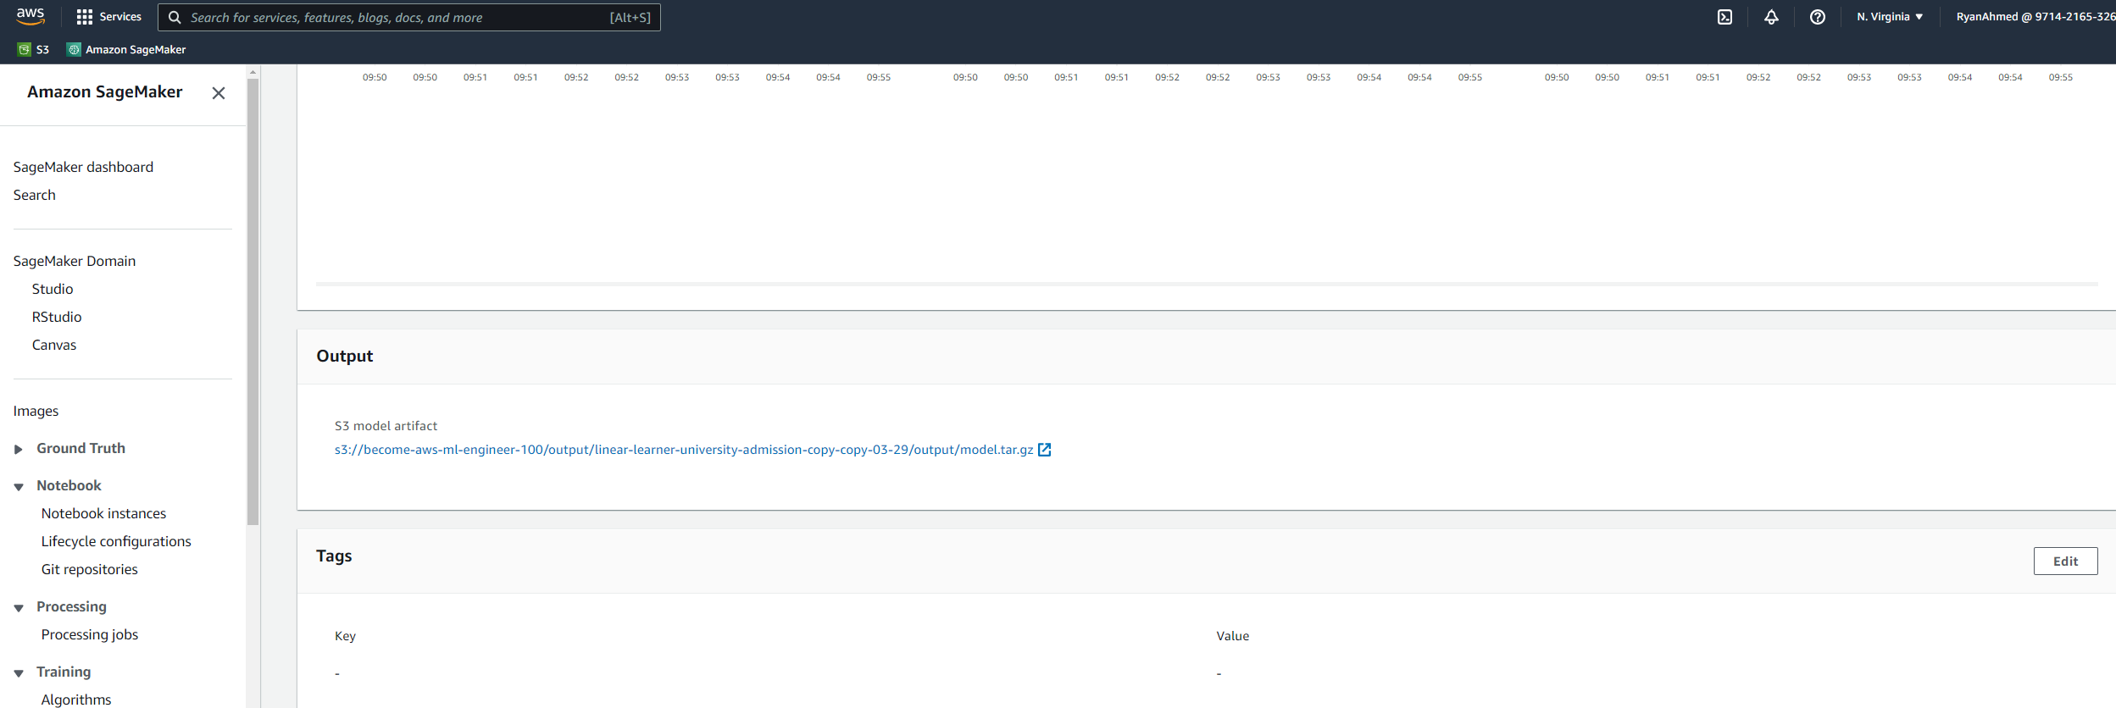
DEMO: LAUNCH TRAINING JOB FROM AWS CONSOLE
ONCE THE TRAINING JOB IS COMPLETE. YOU SHOULD FIND THE TRAINED MODEL ARTIFCATS IN THIS PATH SHOWN BELOW.

Slide 33
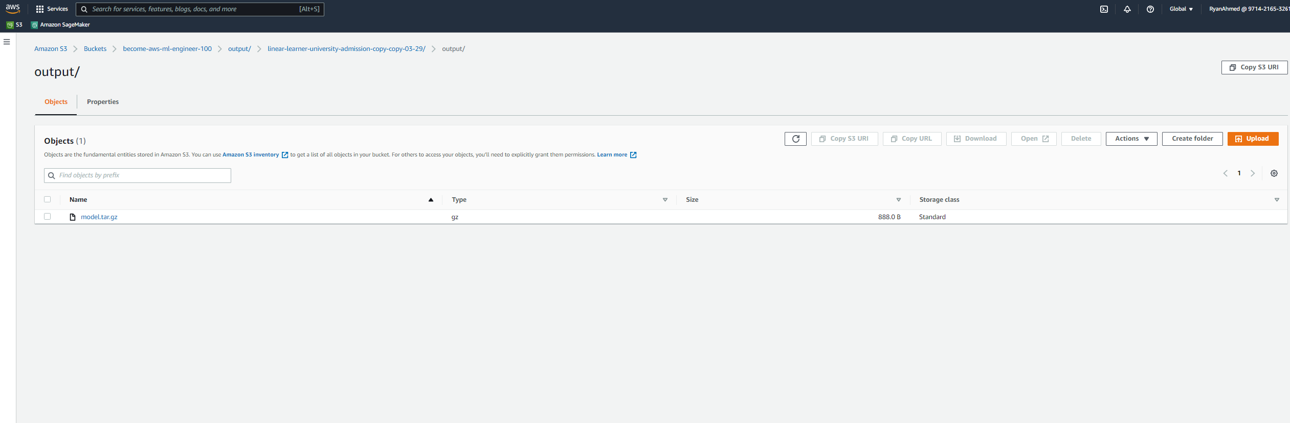
DEMO: LAUNCH TRAINING JOB FROM AWS CONSOLE
TRAINED MODEL OUTPUT IS PLACED IN THE OUTPUT

Slide 34
MODEL DEPLOYMENT
EASY
ADVANCED

Slide 35
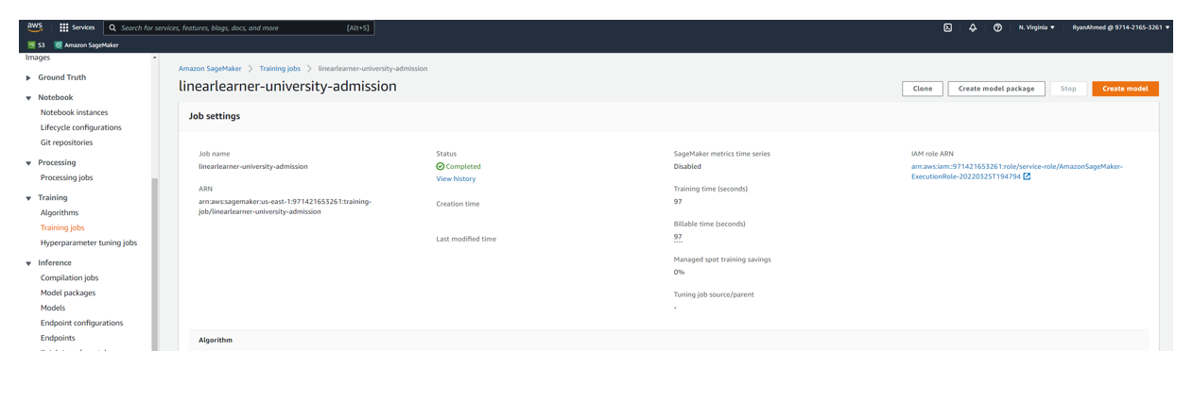
DEMO: LAUNCH TRAINING JOB FROM AWS CONSOLE
ONCE THE TRAINING JOB IS COMPLETE, CLICK ON CREATE MODEL

Slide 36
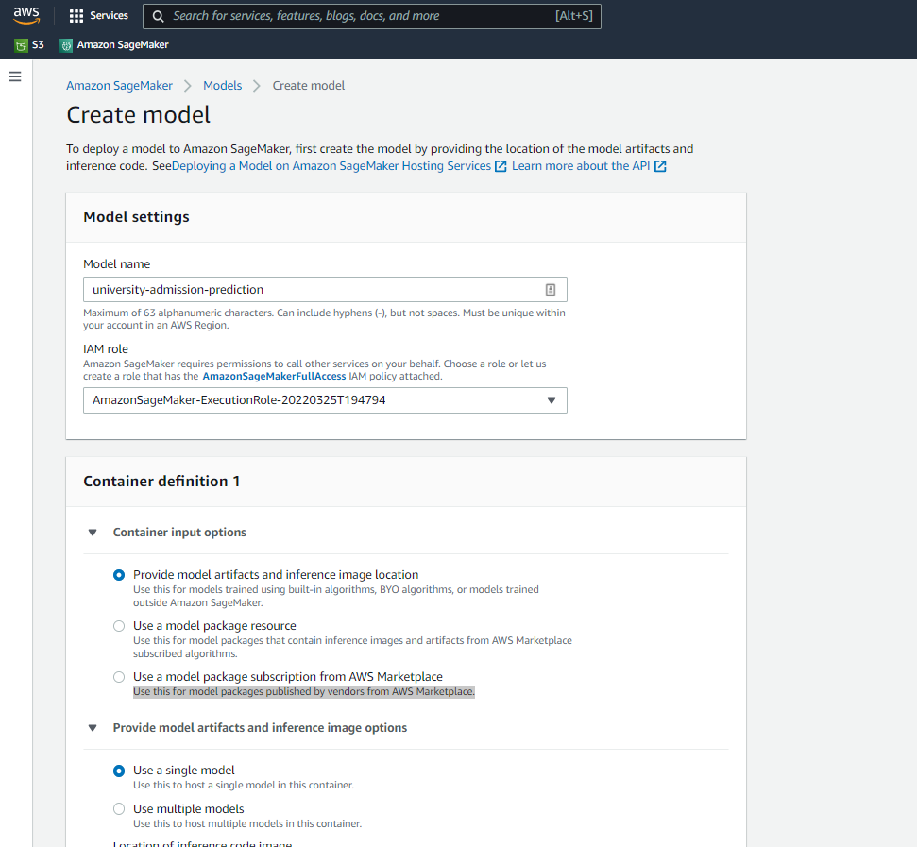
DEMO: LAUNCH TRAINING JOB FROM AWS CONSOLE
PROVIDE A NAME, SELECT THE ROLE AND CLICK CREATE MODEL

Slide 37
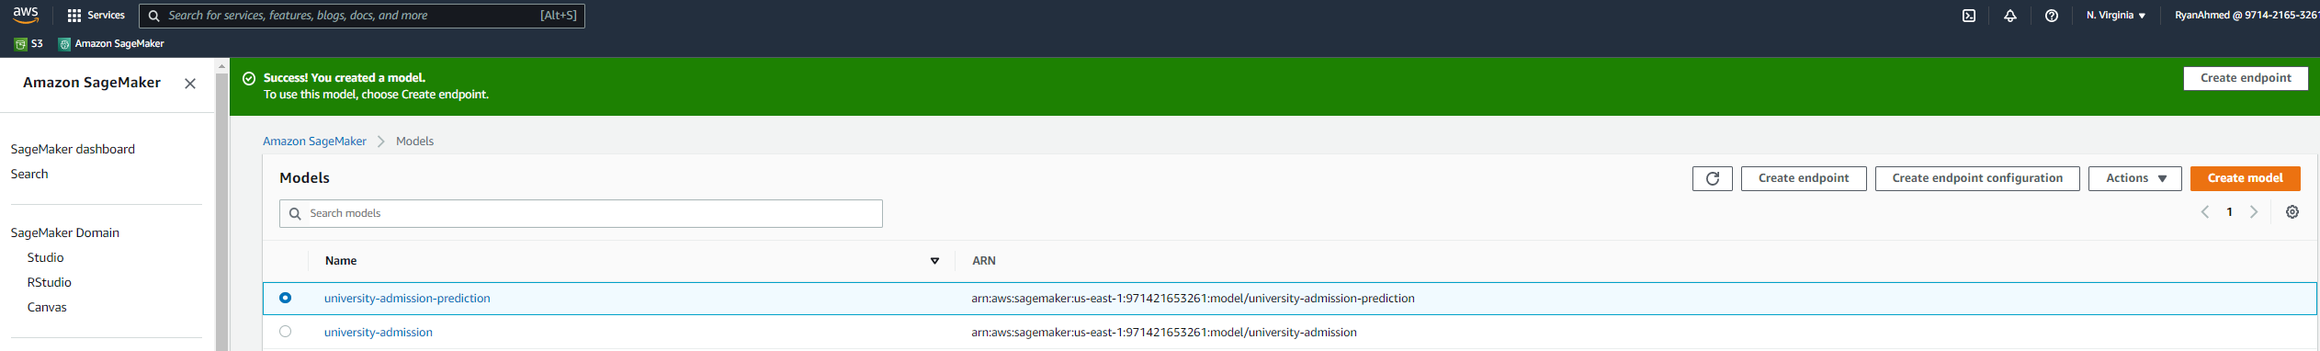
DEMO: LAUNCH TRAINING JOB FROM AWS CONSOLE
CLICK ON CREATE ENDPOINT CONFIGURATION

Slide 38
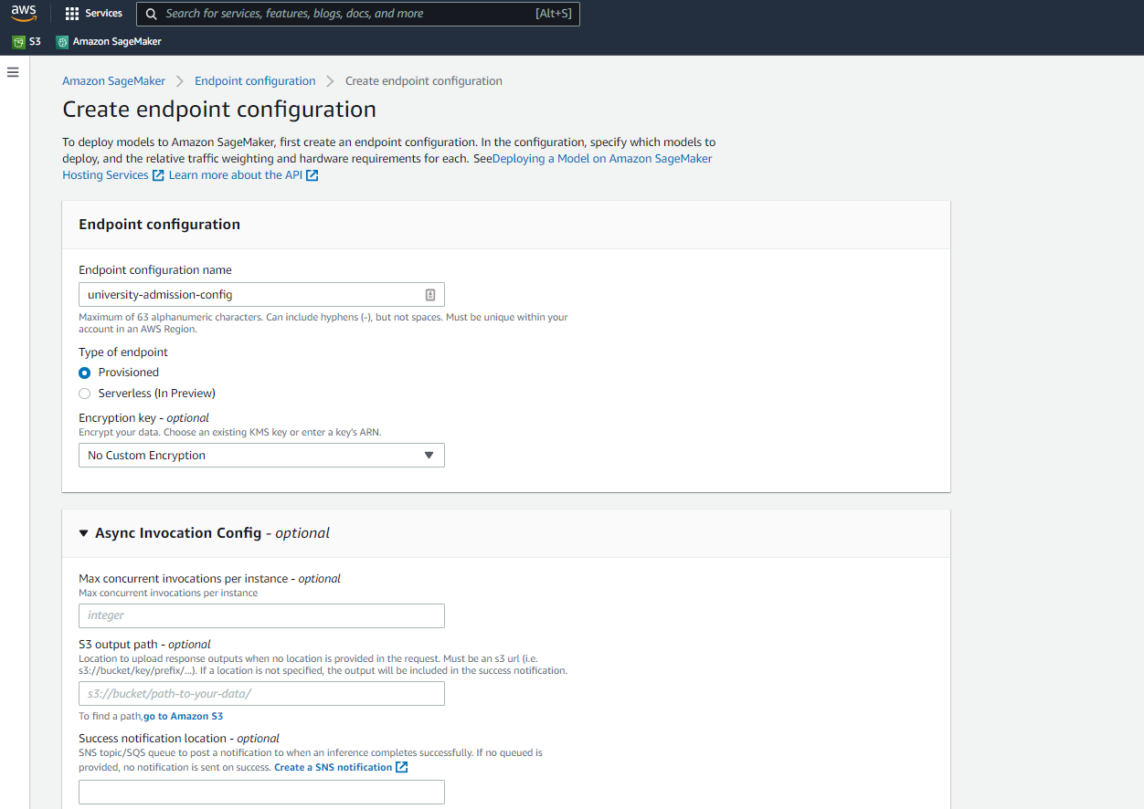
DEMO: LAUNCH TRAINING JOB FROM AWS CONSOLE
PROVIDE A NAME AND CLICK CREATE ENDPOINT CONFIG

Slide 39
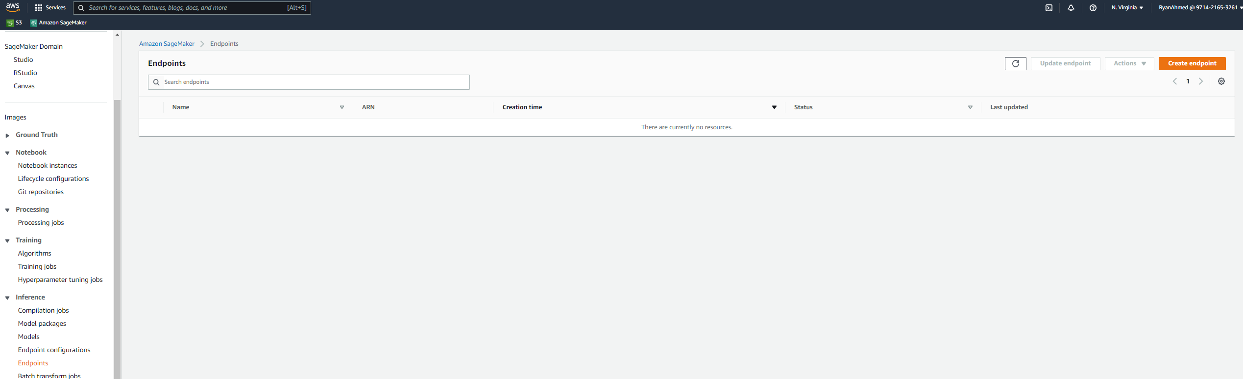
DEMO: LAUNCH TRAINING JOB FROM AWS CONSOLE
NAVIGATE TO ENDPOINTS AND CLICK ON CREATE ENDPOINT

Slide 40
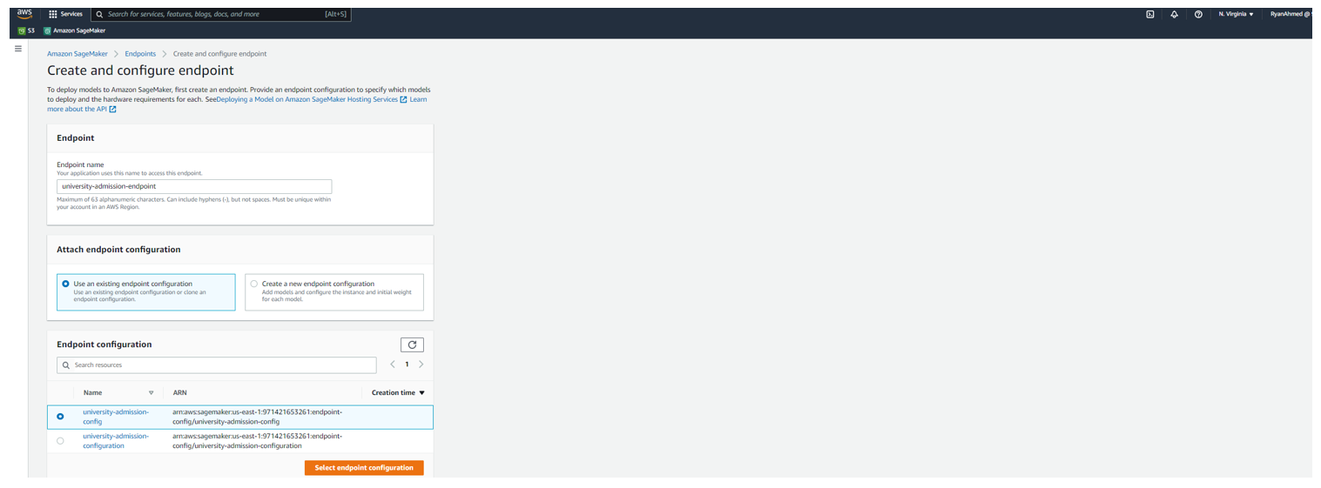
DEMO: LAUNCH TRAINING JOB FROM AWS CONSOLE
PROVIDE AN ENDPOINT NAME AND SELECT THE CONFIGURATION AND CLICK ON CREATE ENDPOINT

Slide 41
FINAL END-OF-DAY CAPSTONE PROJECT
EASY
ADVANCED

Slide 42
PROJECT OVERVIEW: LIFE EXPECTANCY PREDICTION
In this hands-on project, we will train a Linear Regression model to predict life expectancy.
This data was initially obtained from World Health Organization (WHO) and United Nations Website. Data contains features like year, status, life expectancy, adult mortality, infant deaths, percentage of expenditure, alcohol etc.
Tasks:
Upload the dataset Life_Expectancy_test_NoHeader.csv and Life_Expectancy_train_NoHeader.csv to S3
Using AWS management console, train a linear leaner model to predict life expectancy.
Deploy the model and assess its performance. What’s R2?
INPUT FEATURES
PREDICTION
YEAR
ADULT MORTALITY
STATUS
INFANT DEATHS
ALCOHOL
HEPATITIS B
LINEAR LEARNER MODEL
LIFE EXPECTANCY
Source: https://www.kaggle.com/jkumarajarshi/life-expectancy-who

Slide 43
FINAL END-OF-DAY CAPSTONE PROJECT SOLUTION
EASY
ADVANCED

Slide 44
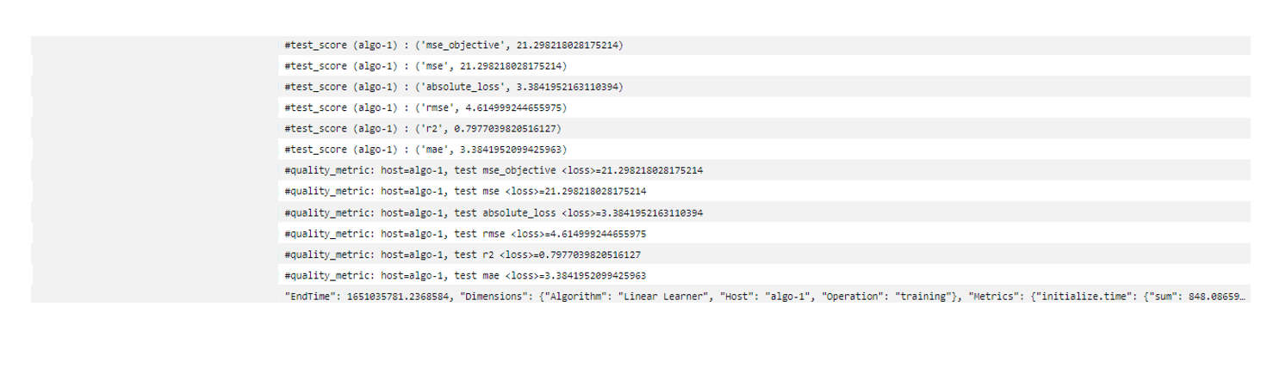
PROJECT SOLUTION

